Slide 1



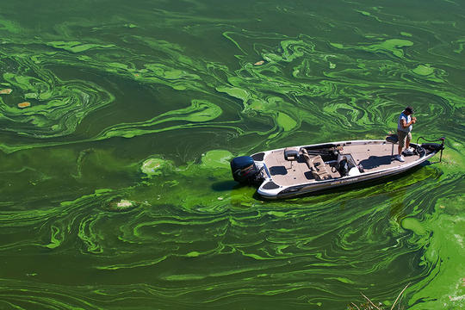
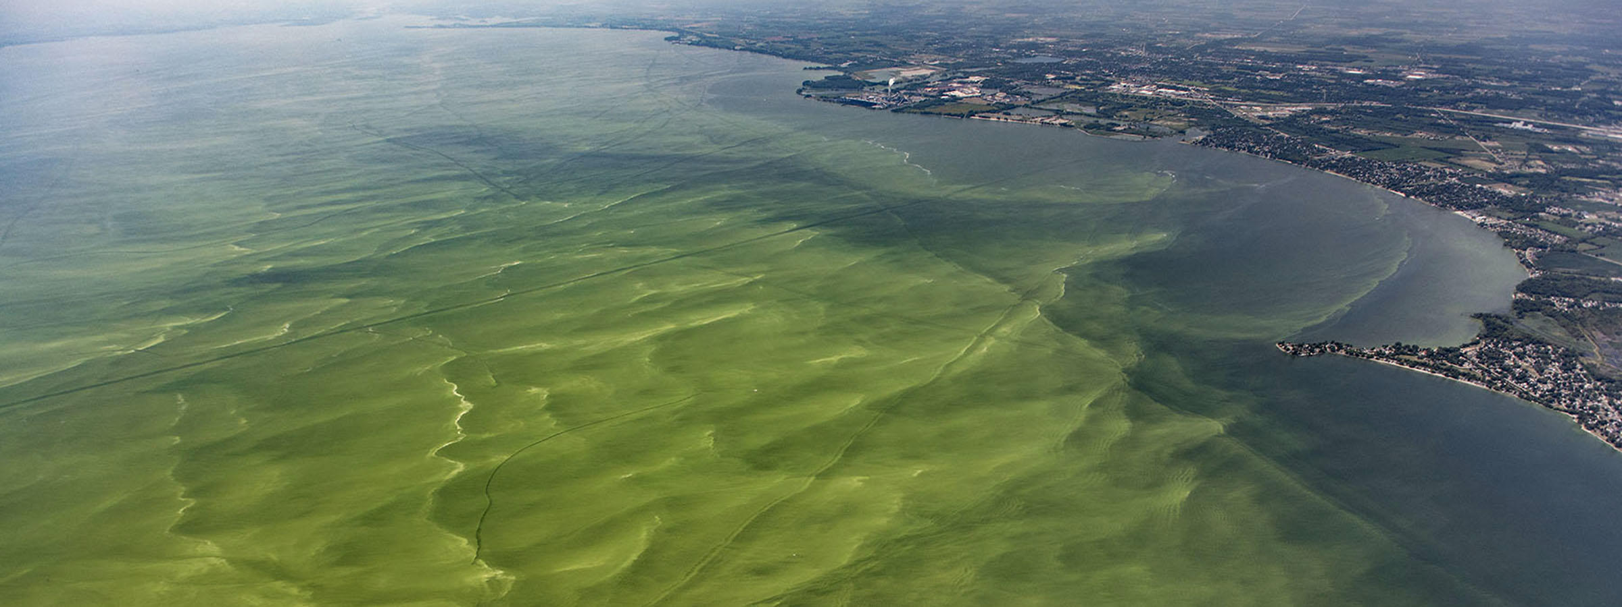

Development of a Predictive HAB Planning Tool using CE-QUAL-W2 Todd Steissberg (Todd.E.Steissberg@erdc.dren.mil, 530-574-5572) Jodi Ryder, Isaac Mudge, Emily Summers, Lauren Melendez
Problem: Existing models inadequately predict the timing, frequency, intensity, spatial variability, and impacts of Harmful Algal Blooms (HABs).
Solution: Develop a predictive HAB planning tool using ERDC’s reservoir water quality model, CE-QUAL-W2.
ANSRP Harmful Algal Bloom Congressional Interest In-Progress Review

Slide 2
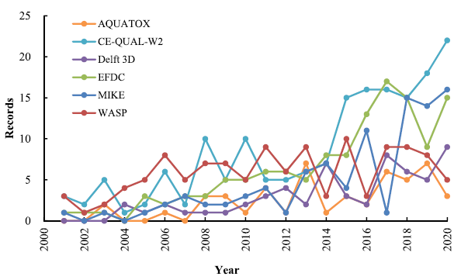
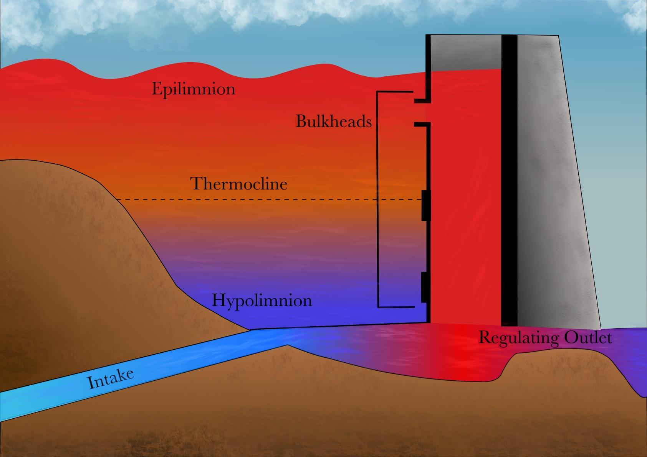
CE-QUAL-W2
CE‐QUAL‐W2 is a two‐dimensional (2D), longitudinal/vertical, hydrodynamics and water quality model that enables characterization of vertical and longitudinal changes in reservoirs.
The model assumes reservoirs are well mixed laterally, with no variation from one channel side to the other in a layer (vertical) and segment (longitudinal).
CE-QUAL-W2 has been applied to rivers, lakes, reservoirs, and estuaries.
Ecological Modelling 466 (2022) 109888

Slide 3
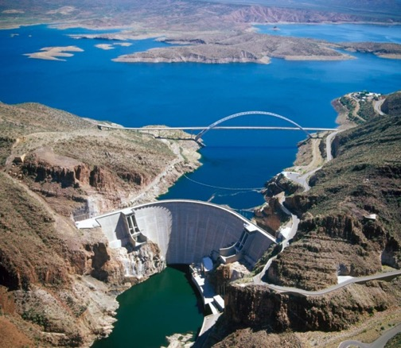
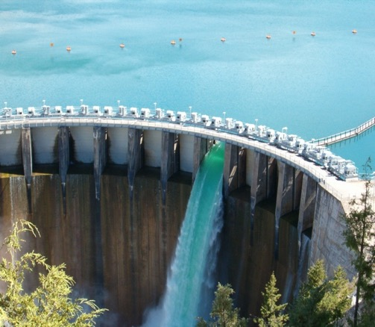
CE-QUAL-W2 Capabilities
Longitudinal-vertical hydrodynamics and water quality in stratified and non-stratified systems
Nutrients-dissolved oxygen-organic matter interactions
Fish habitat
Selective withdrawal from stratified reservoir outlets
Hypolimnetic aeration
Multiple algae, epiphyton/periphyton, zooplankton, and macrophytes
CBOD
Sediment diagenesis model
Generic water quality groups
Internal dynamic pipe/culvert model
Hydraulic structures (weirs, spillways) algorithms, including a dynamic shading algorithm based on topographic and vegetative cover.
Water age – Useful for forensic analyses

Slide 4
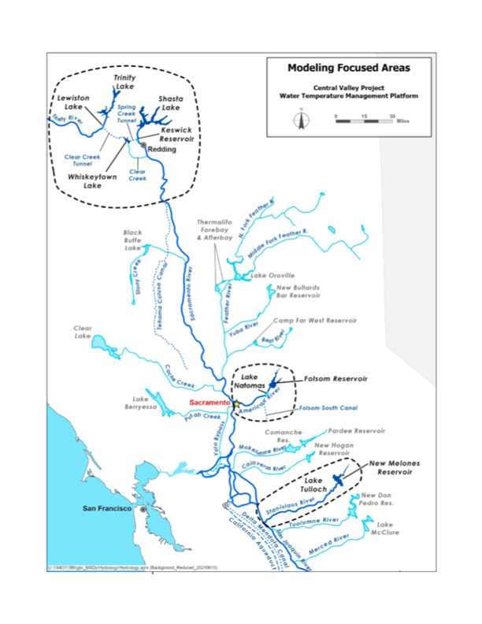
Past and Current Applications of CE-QUAL-W2
CE-QUAL-W2 is widely used by USACE and other federal, state, and local agencies for environmental impact assessments, planning studies, etc. Agencies that use CE-QUAL-W2 as their standard reservoir water quality model include:
U.S. Geological Survey (USGS)
U.S. Bureau of Reclamation
U.S. Environmental Protection Agency (EPA)
State of California
More than 1,100 model applications have been developed worldwide for reservoirs, rivers, estuaries, and other water bodies since CE-QUAL-W2 was released in 1986.
CE-QUAL-W2 is also used as a research tool by researchers at universities and other organizations.
At least 1,500 publications utilized or cited CE-QUAL-W2 in the year 2022 alone.
Recent Studies:
Water Temperature Modeling Platform, California Central Valley Project (USBR and State of California): This platform applies CE-QUAL-W2 for ongoing and future operations decision-making
USACE Northwest Division, Columbia and Snake River Watershed
Columbia System Reservoir Operation (CRSO) Project
Columbia River Treaty (CRT) Project
Philadelphia District, Lehigh River Water Quality Modeling
Region of Application:
Water Temperature Modeling Platform
California Central Valley Project

Slide 5

CE-QUAL-W2 Benefits
Since it was first released in 1986, CE-QUAL-W2 has been used by water quality managers to assess impacts of management strategies on reservoir, lake, and estuarine systems.
CE-QUAL-W2 computes the two-dimensional velocity field for narrow systems that stratify.
In contrast with reservoir models with simplified hydrodynamics, CE-QUAL-W2 accurately simulates vertical and longitudinal transport of constituents, which can be as important as chemical kinetics in accurately simulating water quality.
Applications of CE-QUAL-W2 include:
Planning Studies
Environmental Impact Assessments
Ecosystem Restoration Projects
Real-Time Systems Operation and Decision-Making

Slide 6
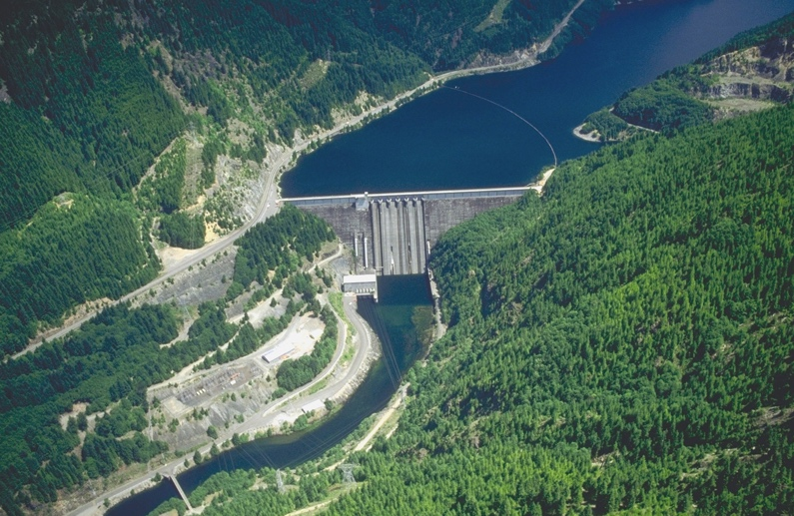
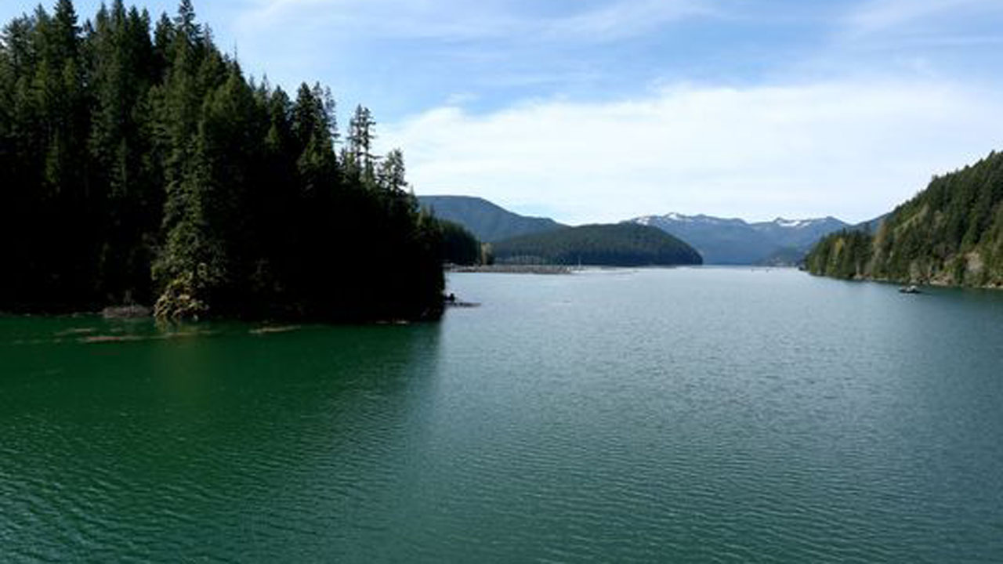
Challenges and Solutions
Developing HAB simulation capabilities applicable to any reservoir is challenging. Reservoirs have characteristics that can vary significantly:
Algal species
Water body morphometry (length, width, etc.)
Volume
Depth
Mixing dynamics (wind forcing, fetch orientation)
Harmful algal blooms can exhibit rapid changes and non-linear dynamics that are difficult to capture in model simulations.
To address these issues:
Extensive literature and model review.
Gather ideas from HAB experts.
Case study site (Detroit Lake) selected to provide adequate data and a range of conditions that enables development of scaling methods.
Consider focusing on one species and generalizing as far as possible to use it as a surrogate for prediction.
Detroit Lake, Oregon
Detroit Lake HAB

Slide 7
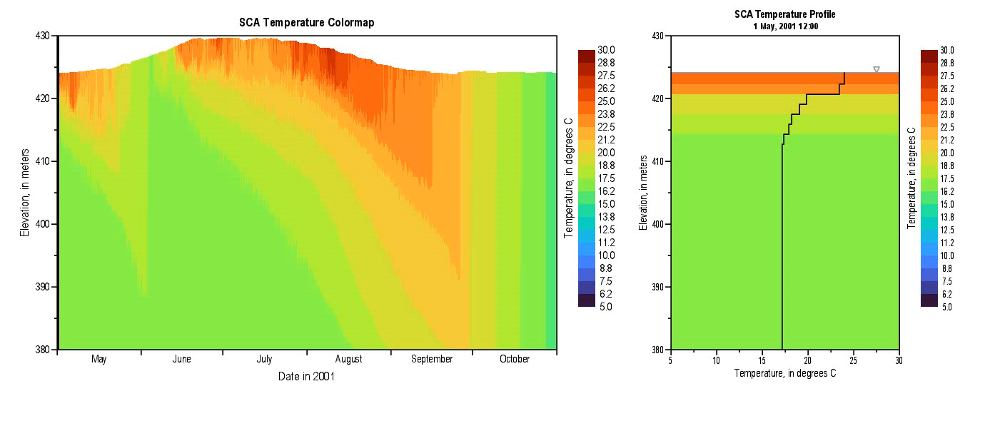
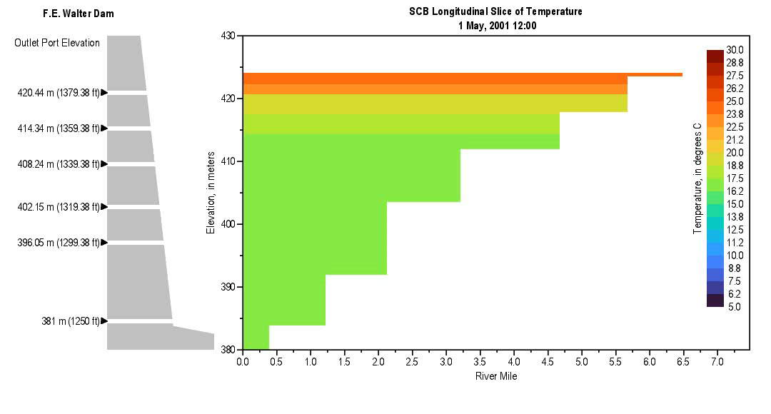
Method and Algorithm Research
Upwelling and boundary mixing dynamics
HABs are not spatially uniform
They are controlled by light penetration, temperature, and nutrient availability
Investigate the role of boundary mixing and upwelling on light penetration and HAB growth
Relate vertical mixing to HAB occurrence and intensity
Nondimensional numbers: Schmidt Stability Index, Wedderburn Number, Richardson Number

Slide 8
Method and Algorithm Research
CE-QUAL-W2 enhancements:
HAB species growth dynamics
Vertical diurnal migration
Nitrogen fixation algorithms (cyanobacteria may outcompete native algae since they can fix nitrogen)
Sub-grid modeling to capture lateral variability (post-processing tool)
Prediction tool:
Use CE-QUAL-W2 outputs and observed cross-sectional data to predict the maximum concentrations and locations of occurrence.

Slide 9

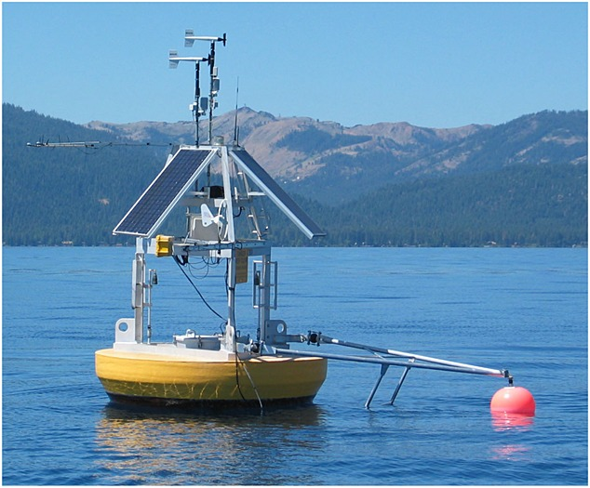
Benefits
The CE-QUAL-W2 HAB prediction tool will simulate HAB occurrences with greater precision.
The tool will provide a real-time understanding of how various environmental factors contribute to HAB dynamics, allowing for timely assessments that can lead to more proactive management.
The data generated will be instrumental in formulating effective mitigation strategies, potentially reducing the frequency and severity of HAB events by targeting identified key contributing factors.
The outputs will facilitate adaptive management practices, where strategies and responses can be continuously refined based on the latest predictive insights.
Accurately simulating HAB events for multiple possible future conditions will improve emergency response protocols, aiding in the preparation and deployment of resources to affected locations efficiently.

Slide 10
Benefits
Through early detection and management of HABs, the model will help protect ecosystem health and public safety, minimizing the adverse effects on wildlife and human populations.
By preventing or minimizing HAB occurrences, the model will indirectly aid in safeguarding local economies dependent on water-related industries such as fisheries, tourism, and recreation.
The outputs will improve communication and help to engage and educate stakeholders, including local communities, policymakers, and environmental organizations, fostering collaboration in HAB management efforts.
The development and refinement of the CE-QUAL HAB models represent significant scientific and technological progress in the field of ecological modeling and environmental management.

Slide 11


Expanding the USACE Toolkit for HABs
Water Quality and Contaminant Modeling, USACE-ERDC
Drs. Jodi L. Ryder, Todd E. Steissberg, Barry W. Bunch
Objective: Create tools to prevent, mitigate, and monitor HABs at USACE projects
Deterministic = Parameterize constituent relationships using empirical data to build system of equations to that describe system behavior.
CE-QUAL-W2
CE-QUAL-ICM
Numerical and analytical
Works best when constituent relationships are well known and static and homogeneous.
Hydro-Meteorology
Model
Hybrid, Blended, Physics Informed = Use deterministic modeling for some constituents and probabilistic for others.
Works best when some aspects of system are well known and homogeneous and others are uncertain, heterogeneous, or dynamic.
BioGeoChemical
Processes
Hydraulics and Operations
Operational
HAB
Management
Probabilistic = Parameterize constituent relationships using statistics and build system of equations to describe
CE-QUAL-W2
CE-QUAL-ICM
Countless others
Probabilistic = Use statistical parameterization and relationships to build system of equations that describe system behavior.
BMA
Random Forest
Data Driven
Most useful when constituent relationships have uncertainty but there is lots of field data to fully bracket the uncertainty.
Jodi.L.Ryder@usace.army.mil, May 2024

Slide 12
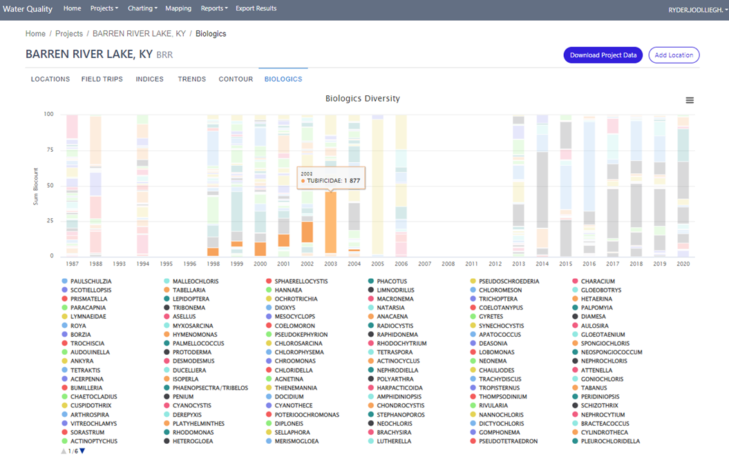
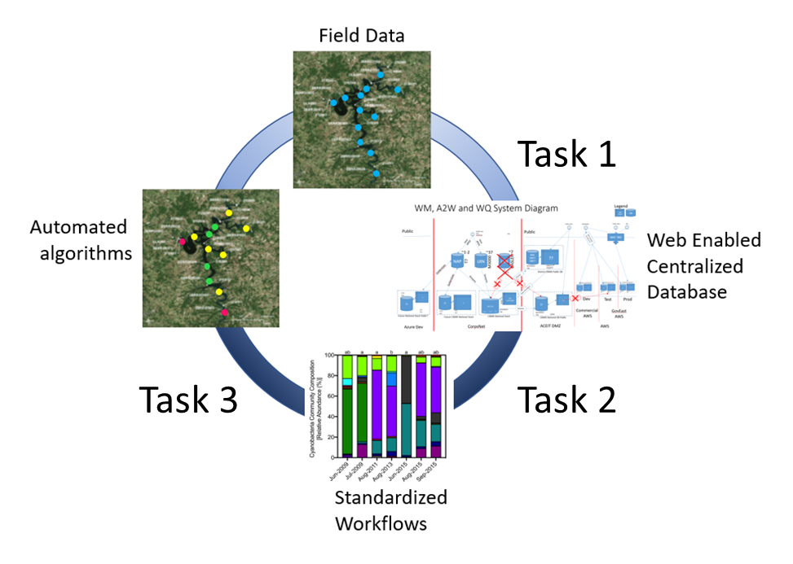
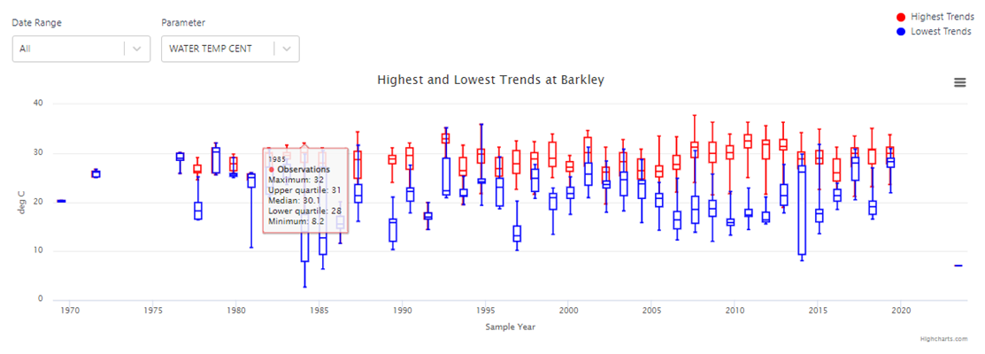
Evaluation of Historic Water Quality Information and Cyanobacteria Harmful Algae Bloom Events Jodi L. Ryder (jodi.l.ryder@usace.army.mil, 601-631-1852), Jeremy Kellett (NAE)
Operationalizing Water Quality Data
Overall Objective
Identify high value water quality and phytoplankton parameters and maximize the information contained in diverse data types
Functionalities created for EWQDB
Data inventory
Inventory maps
Date heatmaps
Multi-factoral filtering
Physical data capabilities
Temperature profile timeseries
Chemical data capabilities
Event and annual statistical charts
Carlson Indicies
Vollenweider Indicies
Biologic data capabilities
Taxonomic diversity plots
Shannon diversity index
Continuing Development
HAB Vulnerability Index (HVI)
Taxonomic diversity plots
Technical Approach
Create algorithms within a unified USACE-wide Enterprise Water Quality Database (EWQDB) for database extraction, statistical analysis, and post-processing to generate a HAB Vulnerability Index (HVI)
Statistical charting
Jodi.L.Ryder@usace.army.mil, May 2024

Slide 13
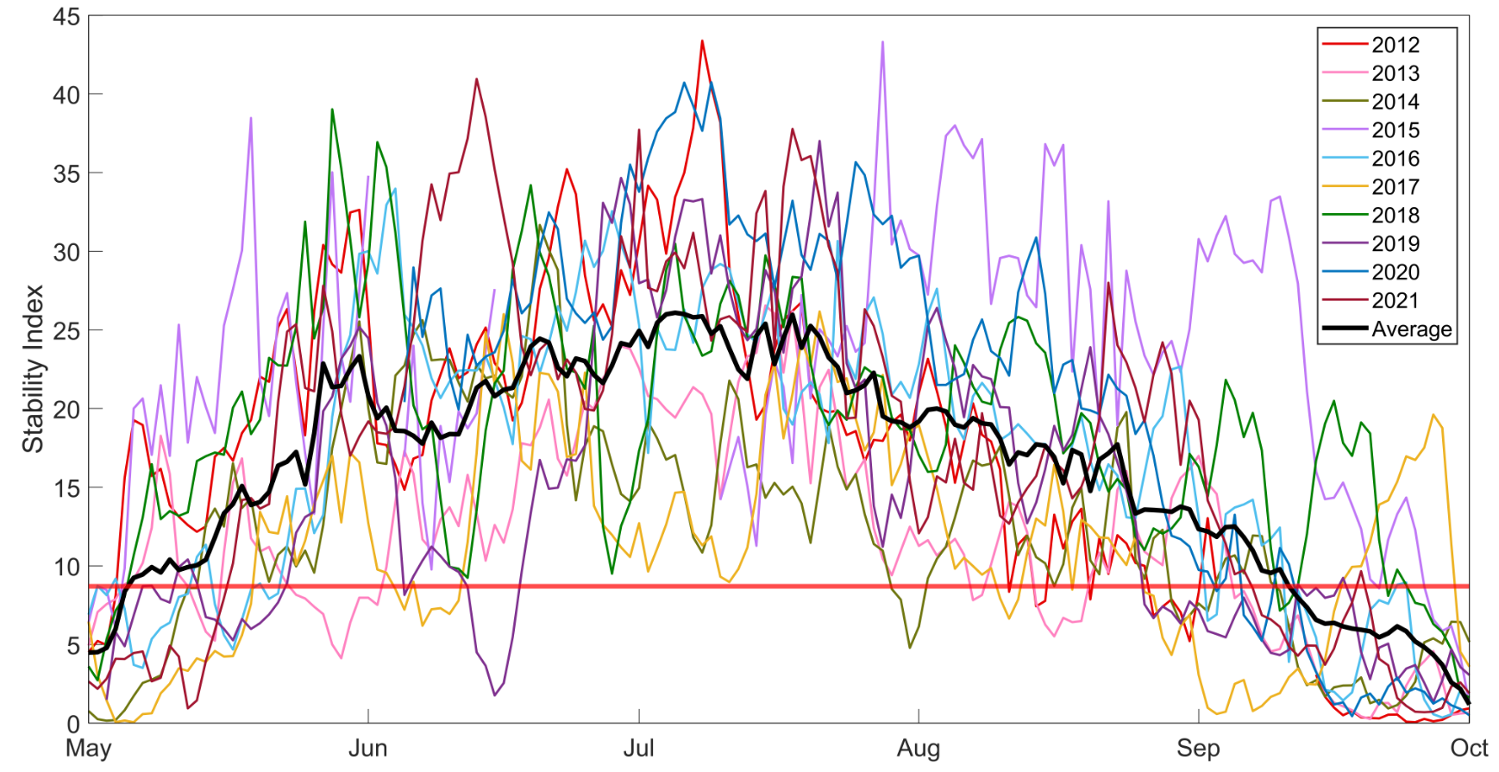
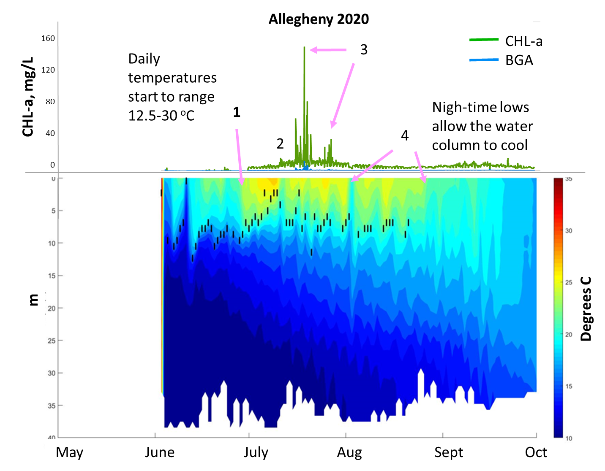
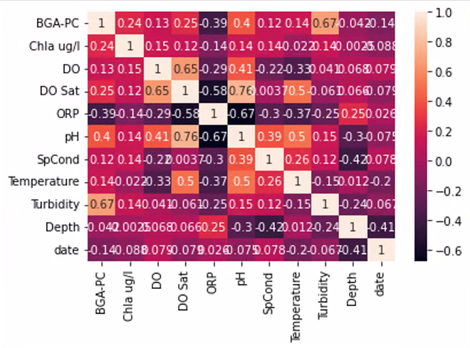
Developing Deterministic Parameters that Enhance Monitoring Activities and Enable Probabilistic Modeling
High frequency monitoring
Water temperature profiles, chlorophyll-a, phycocyanin, DO, water depth
Stability Index Vulnerability Analysis (SIVA)
Utilizes the Schmidt Staility Index formulation of Sahoo (2016) to create a high frequency physically informed parameter for additional analysis.
Forecasting HABs with Advanced Statistical Models
Annual stratification patterns and
climate effects on reservoirs
Summers and Ryder, 2023
Operational
HAB
Management
Month | % Lakes with SI Increasing
May | 20%
June | 80%
July | 100%
Aug | 80%
Sept | 80%
LSTM, GRU, etc.
Summers and Ryder, 2024
May, 25, 2023
POC: Jodi.L.Ryder@usace.army.mil
Jodi.L.Ryder@usace.army.mil, May 2024

Slide 14

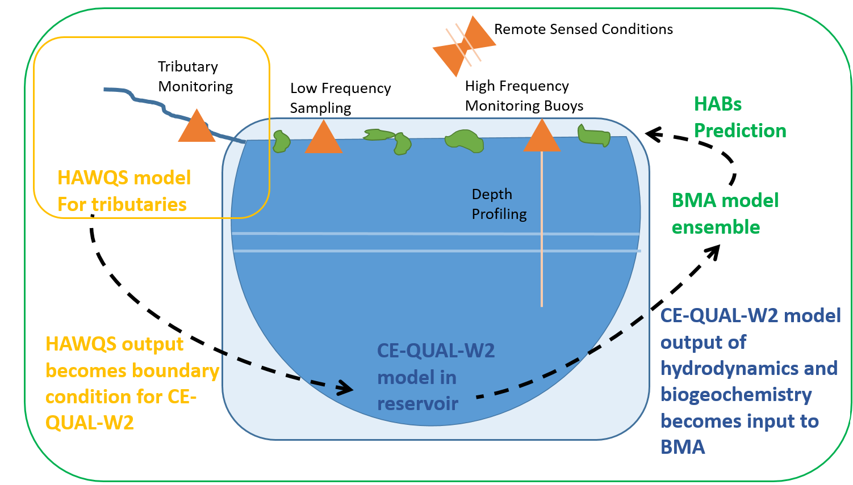
Improved HAB Prediction Using Hybrid Models
Hybrid Modeling System Under Development
HAWQS improves boundary information.
CE-QUAL-W2 enables a spatial component grounded in validated nutrient-water quality processes.
BMA machine learning adds a capability to integrate all available empirical data sources such as satellite imagery, water samples, and weather data
Operational
HAB
Management
May, 25, 2023
POC: Jodi.L.Ryder@usace.army.mil
Jodi.L.Ryder@usace.army.mil, May 2024

